Slide 1
4.7 Protections for Software
1-<number>

Slide 2
Software Copyrights
Copyright protection began 1964
What gets copyrighted?
  Expression of idea, not idea itself
  Object program, not source program
Companies treat source code as a trade secret
1-<number>

Slide 3
Violations of Software Copyrights
Copying a program to give or sell to someone else
Preloading a program onto the hard disk of a computer being sold
Distributing a program over the Internet
1-<number>

Slide 4
Important Court Cases
Apple Computer v. Franklin Computer
  Established that object programs are copyrightable
Sega v. Accolate
  Established that disassembling object code to determine technical specifications is fair use
1-<number>

Slide 5
Safe Software Development
Reverse engineering okay
Companies must protect against unconscious copying
Solution: “clean room” software development strategy
  Team 1 analyzes competitor’s program and writes specification
  Team 2 uses specification to develop software
1-<number>

Slide 6
Software Patents (1/3)
Until 1981, Patent Office refused to grant software patents
  Saw programs as mathematical algorithms, not processes or machines
U.S. Supreme Court decision led to first software patent in 1981
Further court rulings led to patents being granted for wider range of software
1-<number>

Slide 7
Software Patents (2/3)
Thousands of software patents now exist
  Microsoft files ~3,000 applications annually
  Licensing patents a source of revenue
Secondary market for software patents
  Patent trolls: Companies that specialize in buying patents and enforcing patent rights
  Companies would rather settle out of court than spend time and money going to trial
  RIM didn’t settle quickly; ended up paying $612 million
1-<number>

Slide 8
Software Patents (3/3)
Critics say too many patents have been issued
  Patent Office doesn’t know about prior art, so it issues bad software patents
  Obvious inventions get patents
Companies with new products fear getting sued for patent infringement
  Build stockpiles of patents as defense mechanism
  Software patents used as legal weapons
Bezos: software patents should expire in 3-5 years
1-<number>

Slide 9
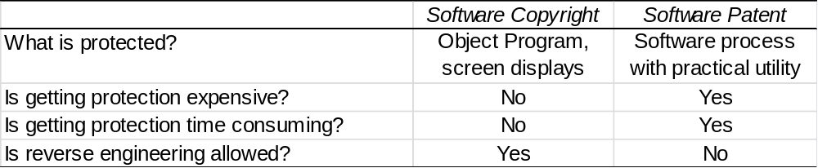
Key Differences between Software Copyrights and Software Patents
1-<number>

Slide 10
4.8 Open-Source Software
1-<number>

Slide 11
Criticisms of Proprietary Software
Increasingly harsh measures being taken to enforce copyrights
Copyrights are not serving their purpose of promoting progress
It is wrong to allow someone to “own” a piece of intellectual property
1-<number>

Slide 12
Open-Source Definition
No restrictions preventing others from selling or giving away software
Source code included in distribution
No restrictions preventing others from modifying source code
No restrictions regarding how people can use software
Same rights apply to everyone receiving redistributions of the software (copyleft)
1-<number>

Slide 13
Beneficial Consequences of Open-Source Software
Gives everyone opportunity to improve program
New versions of programs appear more frequently
Eliminates tension between obeying law and helping others
Programs belong to entire community
Shifts focus from manufacturing to service
1-<number>

